Slide 1
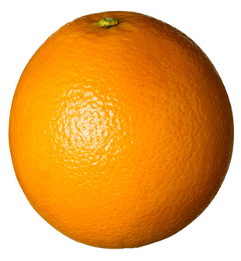
Website Programming
□ JS Operators □ Control Flow

Slide 2
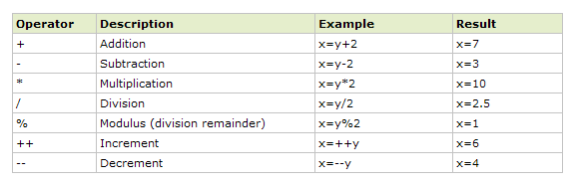
JS Arithmetic Operators
for y=5

Slide 3
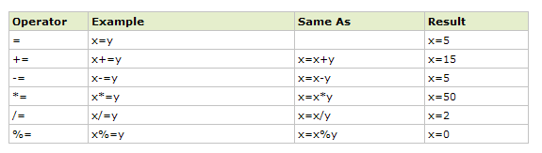
JS Assignment Operators
for x= 10 y=5

Slide 4
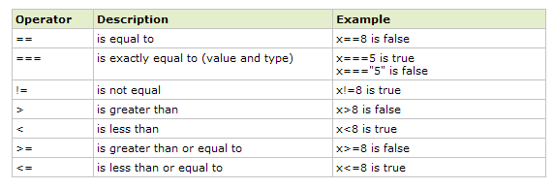
Comparison Operators
for x= 5

Slide 5
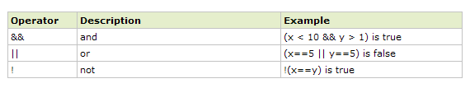
Logical Operators
for x= 6 y=3

Slide 6
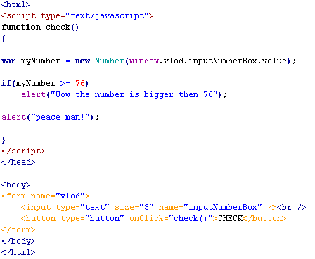
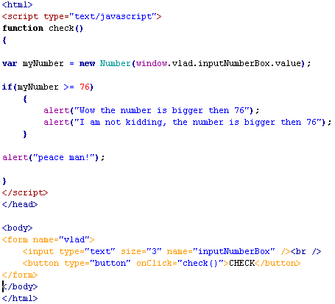
IF
Checks the equality in the if() brackets
If it is TRUE
it executes the line that follows (just one) - the left example
or all the lines in the first bracket that follows - the right example
If it is FALSE will continue with out executing the lines/s - goes to “peace man!”

Slide 7
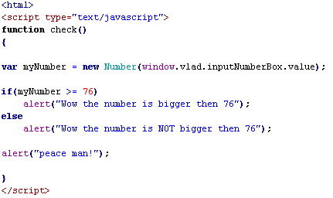
IF/ELSE
The same like if() statement but the difference is when the equality is FALSE, will execute the line/s in the else part
It could have brackets or not like in the if example
true part
false part
every time

Slide 8


if the instruction that follows the conditional testing is made of only one line of code you can write it without using curly brackets
this instruction could be on the same line with the condition or immediately under the condition
you can still use brackets, but....there is no point, maybe just for aesthetics

Slide 9


if the instructions consist of more then one line of code it is compulsory to use the curly brackets
some programmers are using the brackets like this (the starting bracket is always on the same line with the end of the conditional testing):

Slide 10

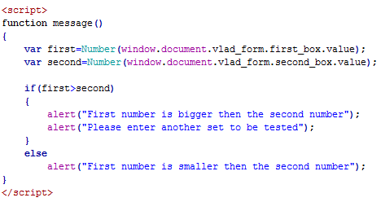
the JS interpreter considers this way of writing code perfectly legal
the indentation is just for our own organisation
you still have to keep the space after var or else
which is the same with this:

Slide 11
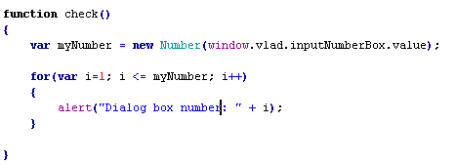
FOR
Executes a statement for a specified number of times.
You define a variable i and as long it is smaller or equal with the number the user entered will executes the statement inside the brackets.
Each time the statement is executed the variable i is incremented by 1.

Slide 12
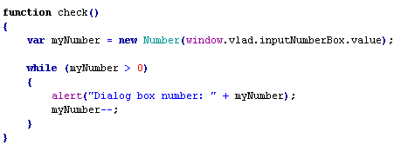
WHILE
Executes a statement for as long a condition is TRUE
You define a condition inside the while() brackets
In this case each time the ‘alert’ statement is executed the ‘myNumber' variable is decremented by 1.

Slide 13
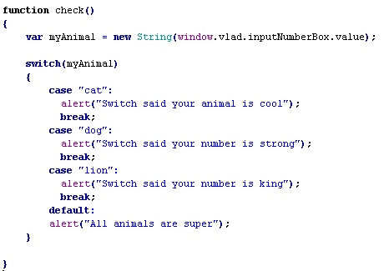
SWITCH
Executes a specific statement when the variable that is checked is matching one of the cases
If none match, the default value will be executed

Slide 14


Multiple selection statements
One condition: to buy alcohol you have to 18 years old (age>18)
Two conditions: to get your plates you need to be 18 and to know how to drive (age>18) AND (skills=good)
Two conditions: to use the public transport you need to buy ticket or to have a pass (buy ticket) OR (pass)
AND
OR

Slide 15
AND truth table
test1 | test2 | AND result | example
TRUE | TRUE | TRUE | ((1<2)&&(1<3))
TRUE | FALSE | FALSE | ((1<2)&&(1>3))
FALSE | FALSE | FALSE | ((1>2)&&(1>3))
FALSE | TRUE | FALSE | ((1>2)&&(1<3))

Slide 16
OR truth table
test1 | test2 | AND result | example
TRUE | TRUE | TRUE | ((1<2)||(1<3))
TRUE | FALSE | TRUE | ((1<2)||(1>3))
FALSE | FALSE | FALSE | ((1>2)||(1>3))
FALSE | TRUE | TRUE | ((1>2)||(1<3))

Slide 17
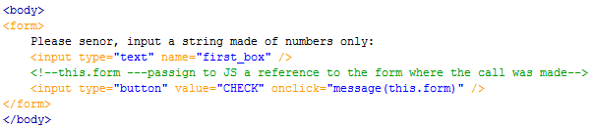
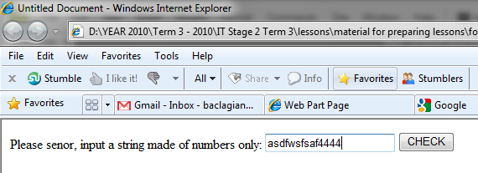
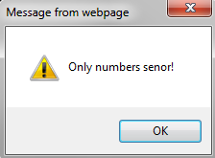
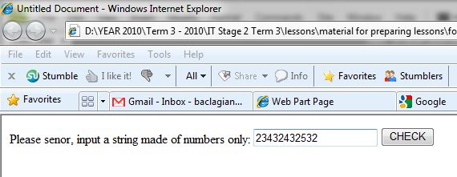
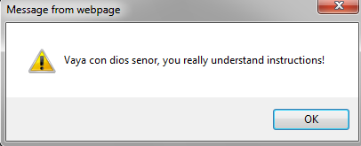
example
I want to check if a string entered by user is a number
if I find a letter an error dialog should pop up

Slide 18
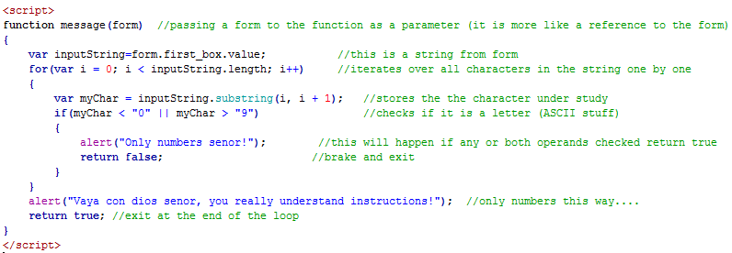
Few things to mentions here:
the way I pass the form to the JS, you do not have to mention which form was used as long you call the function by using "this.form" construct
comparing characters is done by comparing their position in the ASCII table
for example A < B will return TRUE because A is before B in the ASCII table

Slide 19
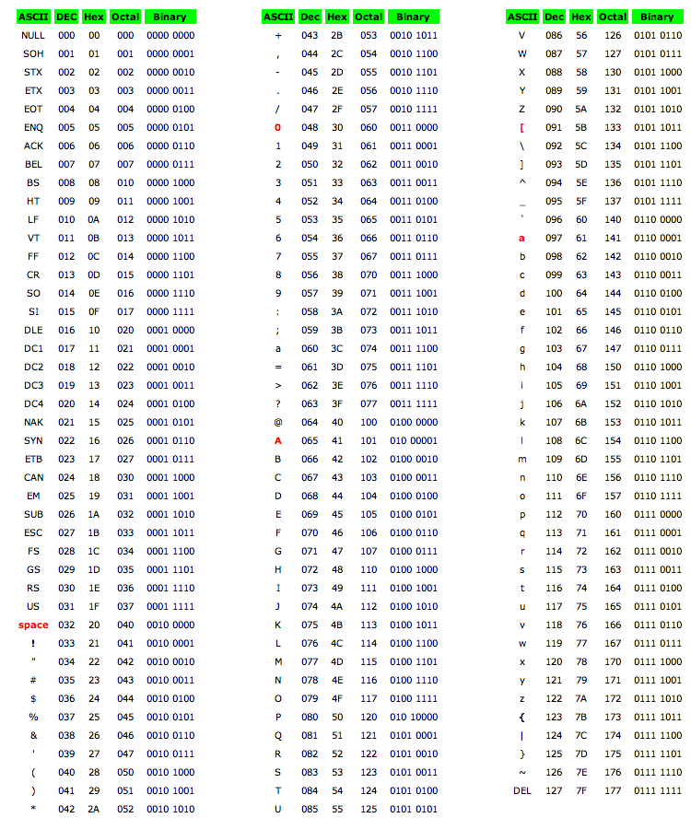
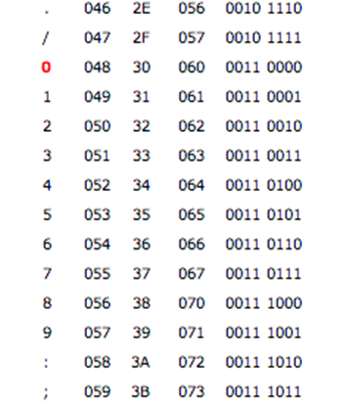
ASCII

Slide 20
USER GUIDE Task 5: Conditional statements
Problem: in your User Guide create an HTML and JavaScript program that does the followings:
compare the age of two people using IF/ELSE statements in two ways; one way by using 3 tests and the second way using 2 tests
using 3 tests means that you have to create 3 IF conditions
using 2 tests means that you have to use just 2 IF conditions
you have to be able to properly nest them

Slide 21
write a program that takes a number from the user
prints all the numbers starting from 1 up to the number
prints them on separate lines
and prints the number as many times it represents
for example if the user inputs 4, you should get:
1 OR 01
22 0202
333 030303
4444 04040404

Slide 22
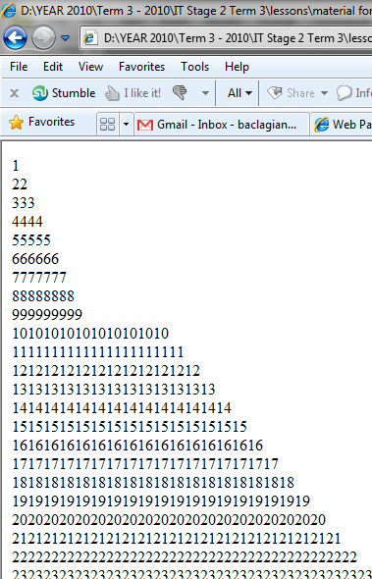
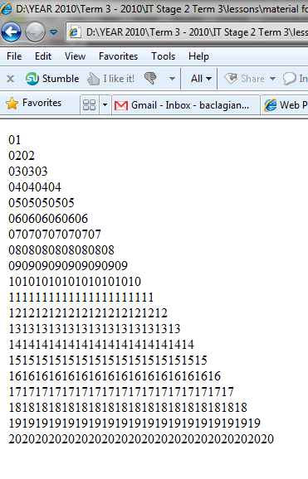

Slide 23
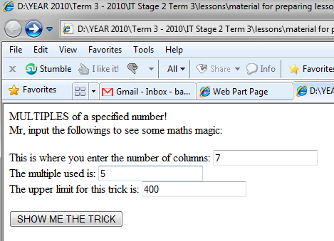
write a program that shows the multiple of a number up to a specified upper limit
the multiples are written in a table with a number of columns specified by the user

Slide 24
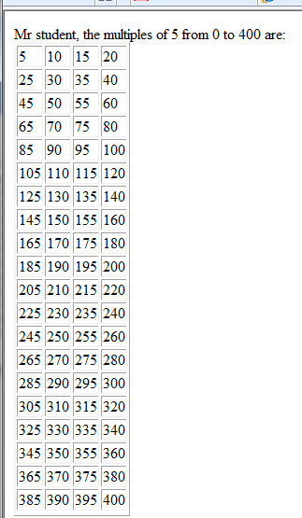
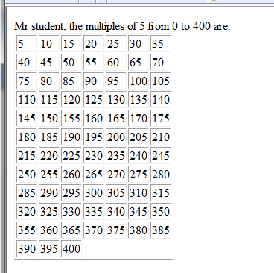
user enters 4 columns
user enters 7 columns
hint: to create a new row check when the % is equal 0

